Slide 1
Arduino interfacing techniques and Industrial considerations

Slide 2
IoT components are designed from software and hardware combined. The hardware interacts with the world while the software performs intelligence.
In electronics, you write a software for a specific hardware platform.
In simple words, interfacing means connecting things together, wiring or combining peripherals with modules, boards or shields.
To understand interfacing, the concepts of electrical circuits need to be applied because we are going to be building intelligent circuits.
Understanding Ohm's law, few concepts of electromagnetics, switches, active and passive electronic components, potentiometers and also the basic concepts of signals and systems will be advantageous

Slide 3
Wiring
Schematic are very important.
Schematic circuit is simple a graphical representation of an electrical or electronic circuit by using symbols.
Schematic circuit shows how components are supposed to look like, how components will be connected in a real circuit.
Any wiring needs to follow standards. Standards are vital since they make every circuit common, meaning that anyone from anywhere can understand the circuit.

Slide 4
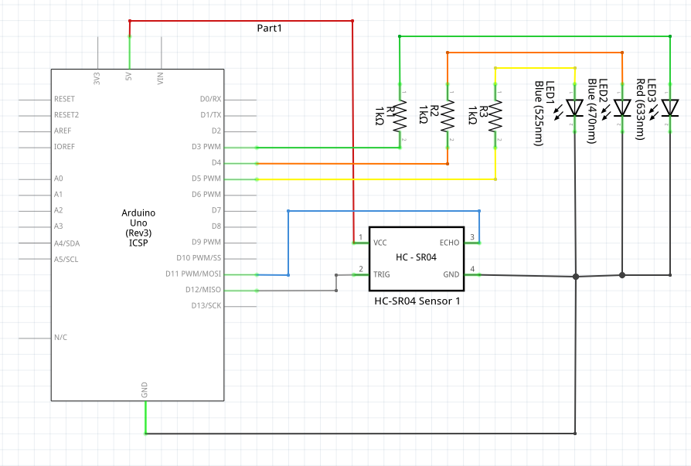
A simple schematic circuit

Slide 5
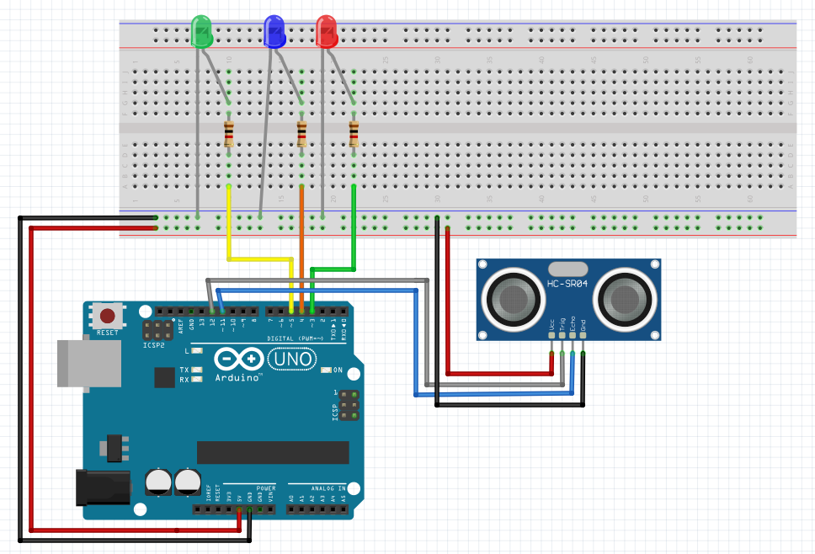
A simple breadboard circuit

Slide 6
A prototype is a first full-scale and usually functional form of a new type or design of a circuit
Breadboads are great for prototyping.
PCB prototyping is simply a sub-process of the actual electronic product prototyping process.
While computer interfacing uses the unidirectional and bidrectional input and output ports to drive various peripheral devices, many simple electronic circuits can be used to interface to the real world either using mechanical switches as inputs, or individual LEDs as outputs.

Slide 7
For an electronic or micro-electronic circuit to be useful and effective, it has to interface with something.
Input interface circuits connect electronic circuits such as op-amps, logic gates, e.t.c to the outside world expanding its capabilities.
Electronic circuits amplify, buffer or process signals from sensors or switches as input information or to control lamps, relays or actuators for output control.
Input interfacing circuits convert the voltage and current output of one circuit to the equivalent of another
Input sensors provide an input for information about an environment
Most of the sensors we can use in our electroni circuits and projects are resistive (resistance changes with the measured quantity)

Slide 8
Input Interfacing circuits
Input interfacing a single switch
DIP switch input interfacing
Switch bounce waveform
RC Switch debounce circuit
Switch debounce with NAND gates
Switch debounce with NOR gates
Interfacing with Opto devices
Slotted optical switch and Slotted opto-switch circuit
Interfacing Photodiodes and LDR Photoresistors

Slide 9
There are many different types of sensors which can be used to convert one or more physical properties into an electrical signal that can then be used and processed by a suitable electronic, microcontroller or digital circuit.
The problem is that just about all of the physical properties being measured cannot be directly connected to the processing or amplifying circuit. Then some form of input interfacing circuit is required to interface the wide range of different analogue input voltages and currents to a microprocessor digital circuit.
Input interfacing circuits allow external devices to exchange signals (data or codes) with another circuit (the processing circuits).

Slide 10
Protection of Arduino against Industrial hazards
It is very important to protect arduino electrically against power supply over voltages, I/O pins over current and voltage and electrostatic discharge.
To protect against over voltages, a zenor diode is used because it works in reverse bias with a predictable breakdown voltage. A schottky diode can be helpful since it has a low voltage drop.
To protect against I/O pins over current and voltage, add an optimal resistor in series with the I/O pin. Care is needed because the current limiting resistor may have an effect on ADC accuracy.

Slide 11
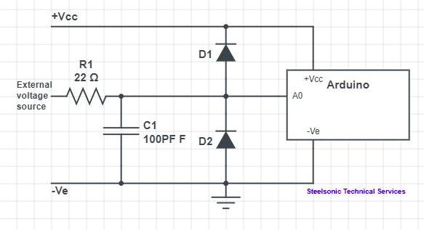
Arduino Input Protection circuit

Slide 12


